Slide 1
WELCOME TO FATHERHOOD/
D’VRAUGHN LE’CLAIRE, LLC PRESENTS
INVESTING:
A MASTERCLASS FOR PERSONAL & FAMILY WEALTH GENERATION

Slide 2
FACILITATOR
Deondre’ Rutues MA, MBA
Trading/Investing since March 2013
Behavioral Economics
Disclaimer: I am not a financial advisor. This Masterclass is for educational purposes only and should not be construed as financial investment advice.

Slide 3
HOUSEKEEPING
MUTE!!!
USE THE CHAT BOX
ENGAGE TO LEARN

Slide 4
LEARNING OBJECTIVES
INVESTMENT MINDSET
5 W’s OF INVESTING
FINANCIAL GOAL SETTING
COMPOUND INTEREST
PROTECT YOUR ASSETS
UNDERSTAND RISK
DIVERSIFICATION
INVESTMENT STRATEGIES
INVESTING IN THE MARKET
STOCK SELECTION
DIVIDENDS
RETURN ON INVESTMENT(ROI)

Slide 5
WHAT IS INVESTING?
THE ALLOCATION OF FUNDS* IN ANTICIPATION OF A PROFIT OR RETURN ON THE ORIGINAL VALUE OF THE ALLOCATED AMOUNT
*ANYTHING OF MONETARY VALUE

Slide 6
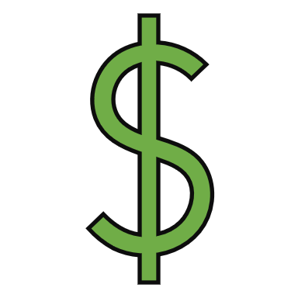
EXPONENTIALLY GROW YOUR MONEY
WHY SHOULD YOU BE INVESTING?
TAKE ADVANTAGE OF COMPOUND INTEREST
CONTROL YOUR FINANCIAL FUTURE

Slide 7
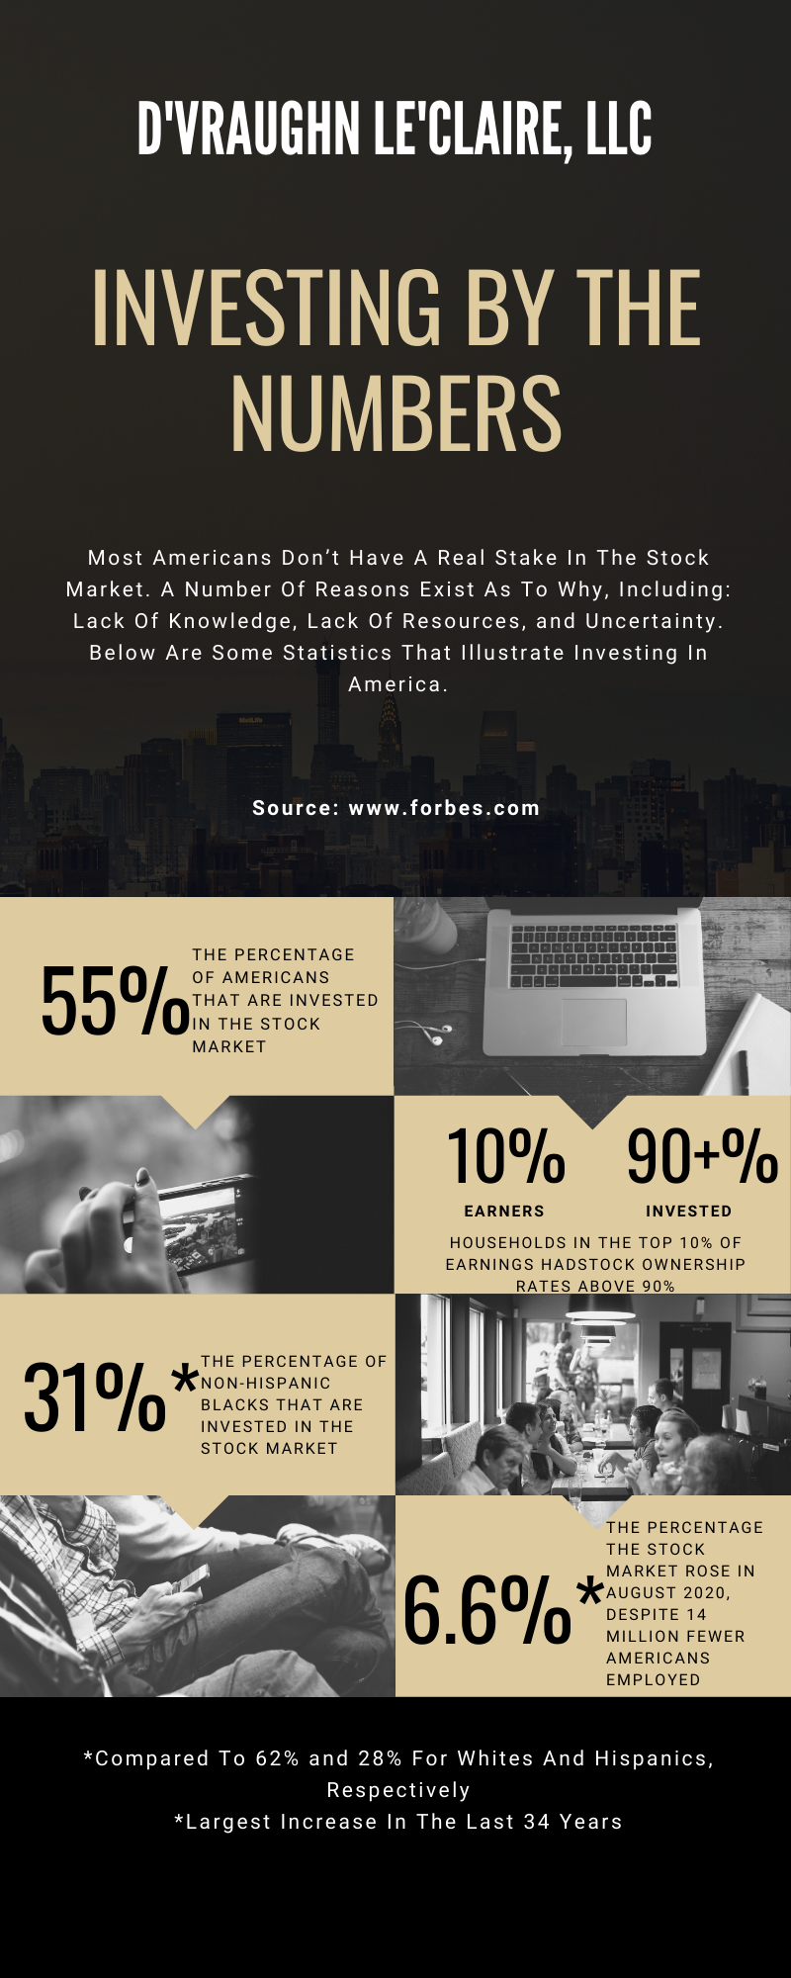
WHO SHOULD BE INVESTING?
The Federal Reserve reports that 39% of Americans don't have enough money on hand to cover a $400 emergency.

Slide 8
WHERE SHOULD YOU BE INVESTING?
CRYPTO
FOREX
MONEY MARKET
PEER TO PEER LENDING
REAL ESTATE

Slide 9
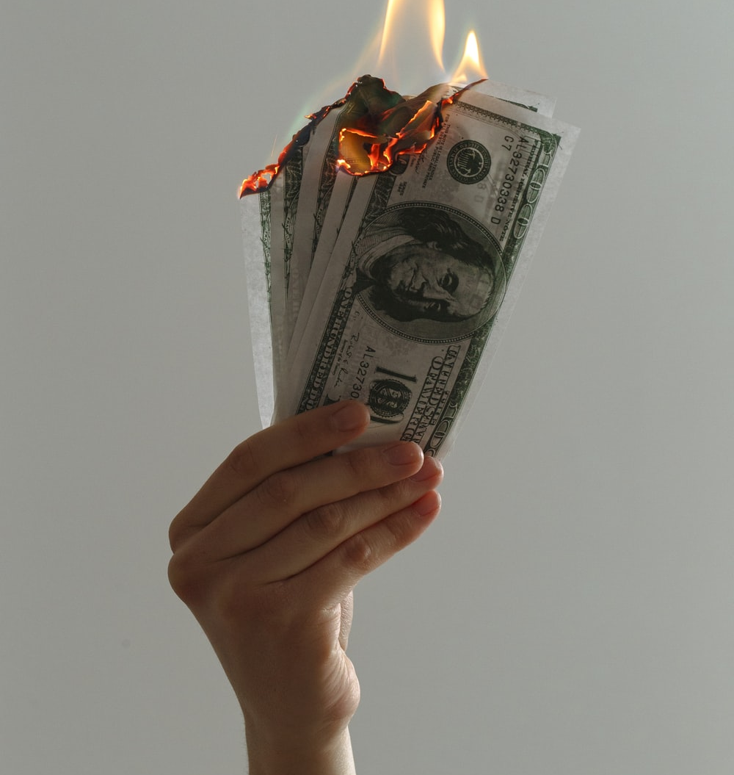
WHEN SHOULD YOU BE INVESTING?
We simply attempt to be fearful when others are greedy and to be greedy only when others are fearful – WARREN BUFFETT

Slide 10
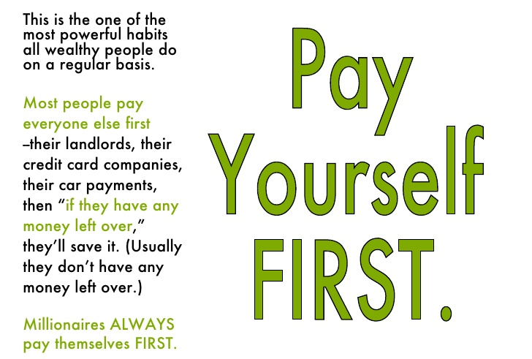
WHO DO YOU WORK FOR?
"How many millionaires do you know who have become wealthy by investing in savings accounts? I rest my case." — Robert G. Allen
YOUR FINANCIAL SECURITY IS IN YOUR HANDS
YOU SHOULD HAVE 10% FOR AN EMERGENCY ACCOUNT
YOU SHOULD HAVE 10% - 20% FOR YOUR SAVINGS INVESTMENT ACCOUNT
The average annual percentage yield (APY) across all savings accounts is just 0.08 percent, according to the Federal Deposit Insurance Corp, while many major banks out there offer yields as low as 0.01 percent.

Slide 11
WHAT’S YOUR PLAN?
ASSESSMENT (EVALUATION)
GOAL SETTING (ACTION PLAN)
EXECUTION (SPECIFIC ACTION)

Slide 12
RULE OF 72
72/RATE OF RETURN = TIME NEEDED FOR INVESTMENT TO DOUBLE
EX. $100 INVESTED AT 12% WILL DOUBLE IN 6 YEARS

Slide 13
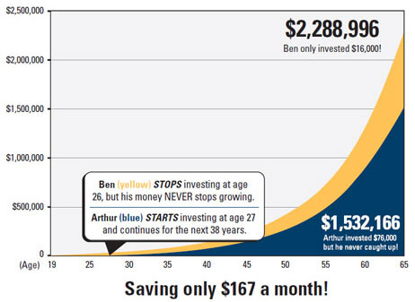
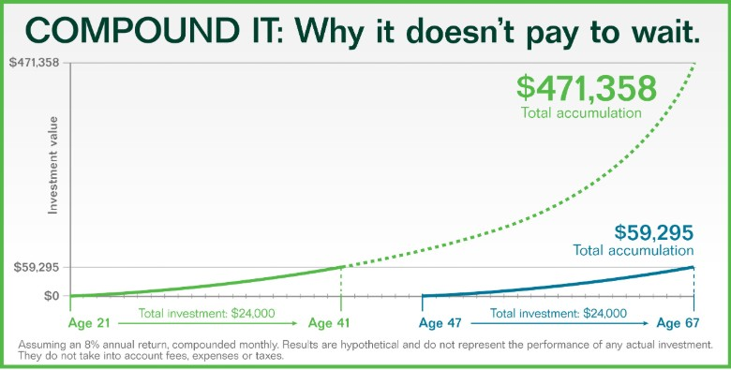

Slide 14
ACTIVITY #1

Slide 15
YOU ARE GOING TO LOSE MONEY!!
RISK
"If you have trouble imagining a 20% loss in the stock market, you shouldn’t be in stocks." — John Bogle

Slide 16
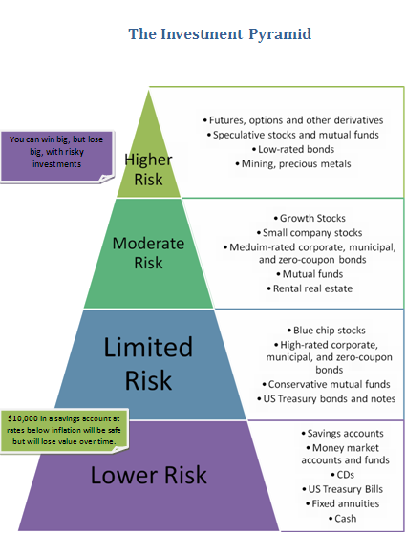
"In investing, what is comfortable is rarely profitable." — Robert Arnott

Slide 17
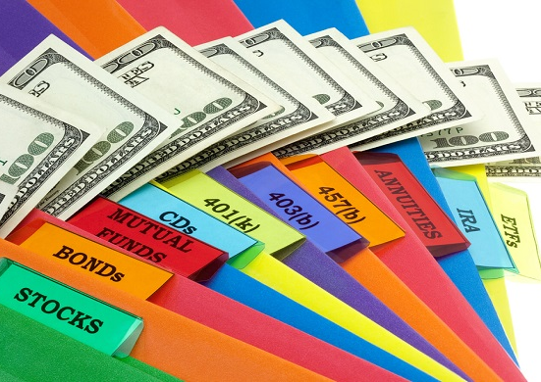
WHAT’S IN YOUR PORTFOLIO?

Slide 18
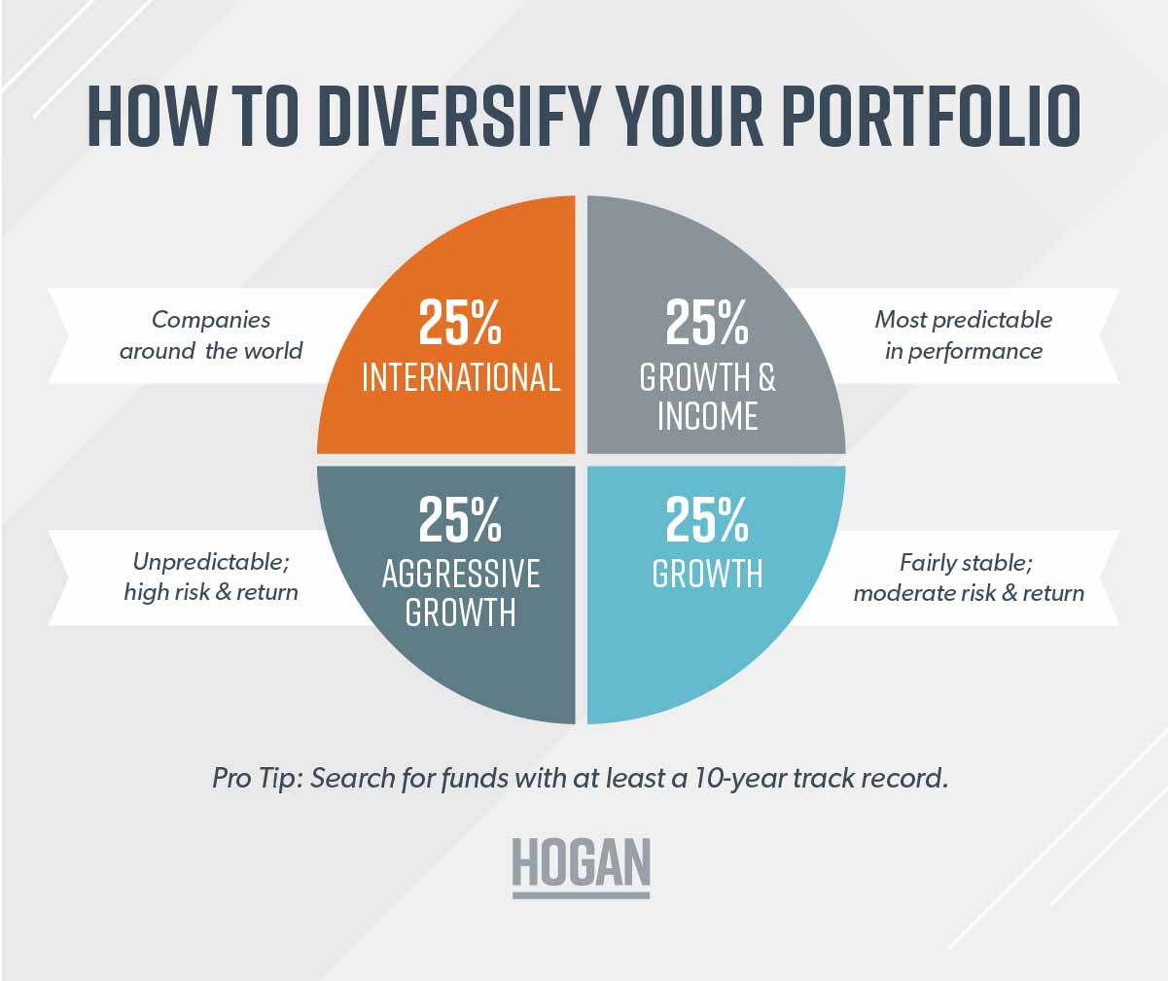
DIVERSIFICATION

Slide 19
ASSET ALLOCATION

Slide 20
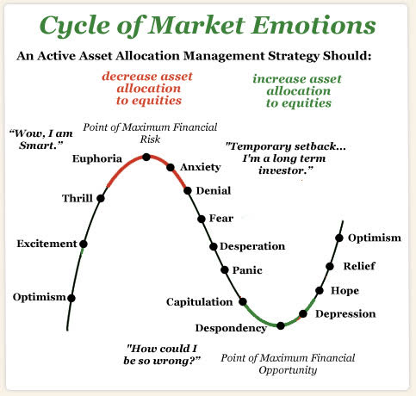
REMOVE YOUR FEELINGS
"The biggest risk of all is not taking one." — Mellody Hobson

Slide 21
ASSESS
RESPOND

Slide 22
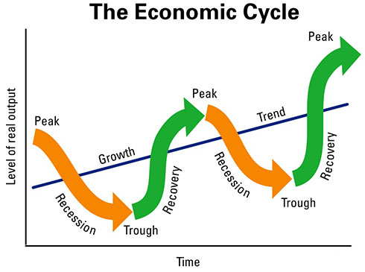
"You get recessions, you have stock market declines. If you don't understand that's going to happen, then you're not ready, you won't do well in the markets." — Peter Lynch

Slide 23
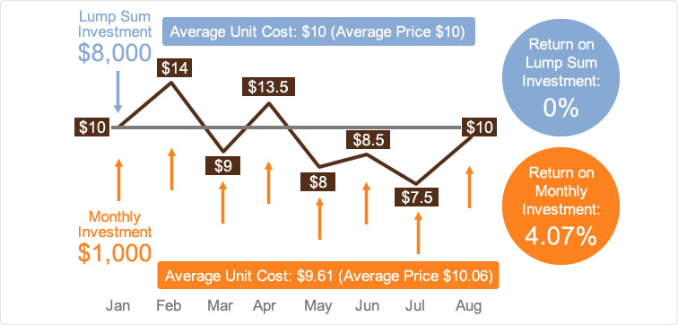
DOLLAR COST AVERAGING
PERIODIC INVESTMENTS MADE REGARDLESS OF ASSET PRICE

Slide 24
DOLLAR COST AVERAGING
PERIODIC INVESTMENTS MADE REGARDLESS OF ASSET PRICE

Slide 25
YOU HAVE TO PAY TAXES ON YOUR INVESTMENTS!!!
CAPITAL GAINS TAX: TAX ON THE AMOUNT EXCEEDING ORIGINAL PURCHASE AMOUNT
CAPITAL LOSS: LOSS INCURRED WHEN SELL PRICE IS UNDER ORIGINAL PURCHASE AMOUNT

Slide 26
ACTIVITY #2

Slide 27
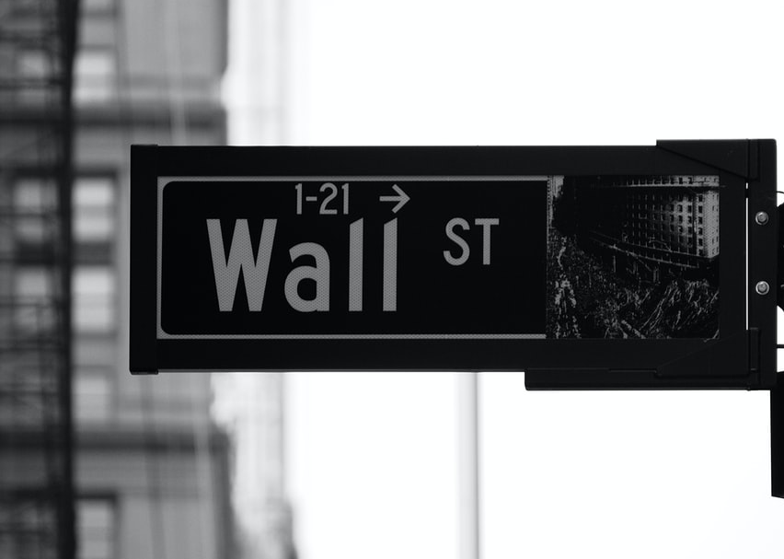
STOCK MARKET
THE STOCK MARKET IS WHERE INVESTORS CONNECT TO BUY AND SELL INVESTMENTS – MOST COMMONLY, STOCKS, WHICH ARE SHARES OF OWNERSHIP IN A PUBLIC COMPANY.

Slide 28
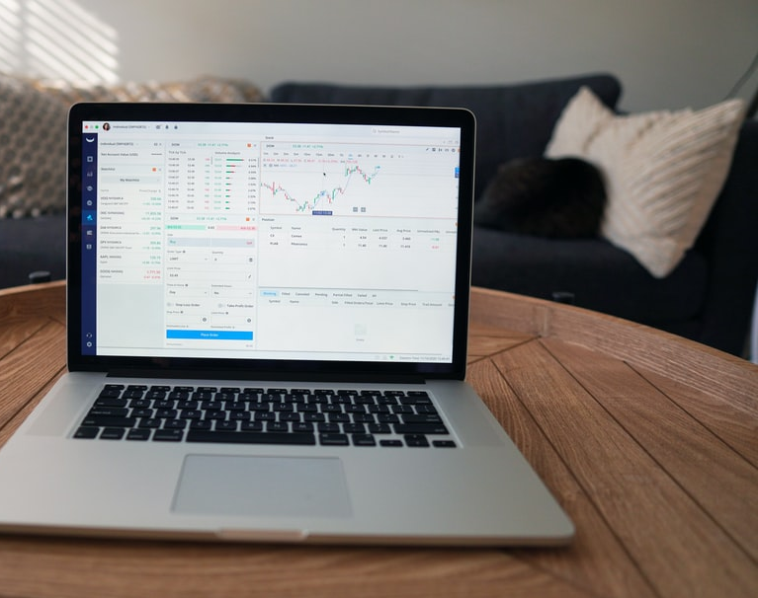
WHAT IS A STOCK?
FRACTIONAL OWNERSHIP OF A COMPANY. YOU MUST PURCHASE SHARES IN ORDER TO OWN A PIECE OF THE COMPANY. MORE SHARES = MORE OWNERSHIP.

Slide 29
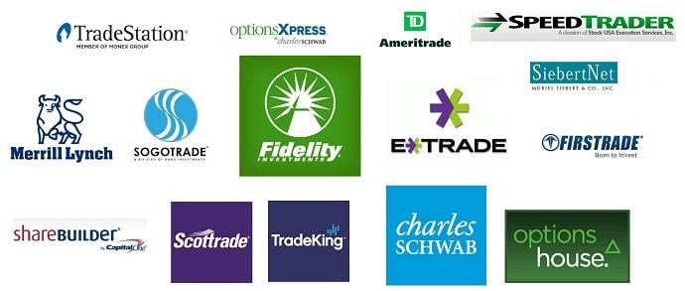
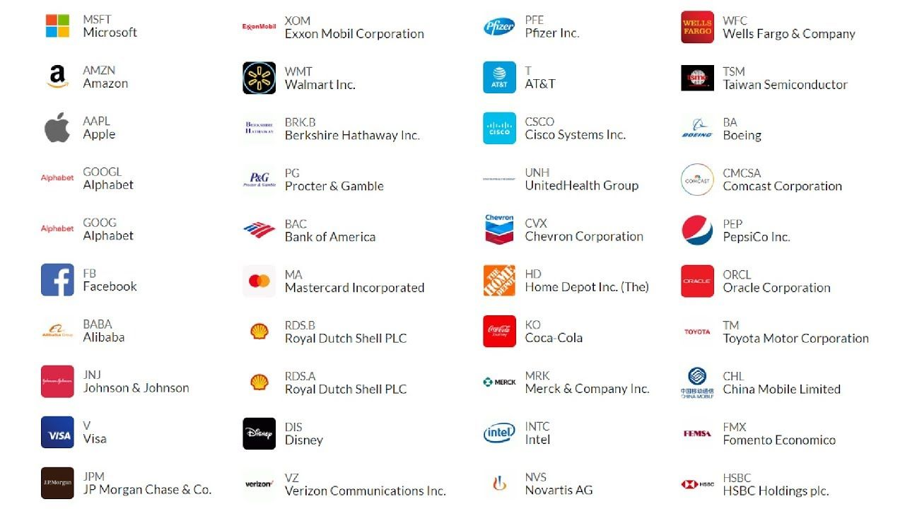
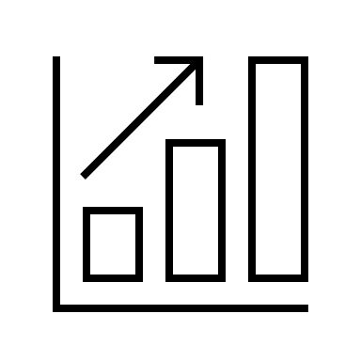
WHAT ARE THE STEPS TO CHOOSING A STOCK?
CHOOSE BROKER
OPEN
ACCOUNT
LOCATE STOCK/TICKER
DECIDE HOW MANY SHARES TO BUY

Slide 30
"Know what you own and know why you own it." — Peter Lynch
TICKER SYMBOL

Slide 32
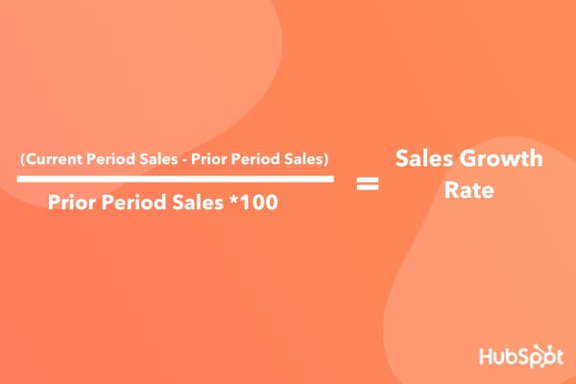

Slide 33
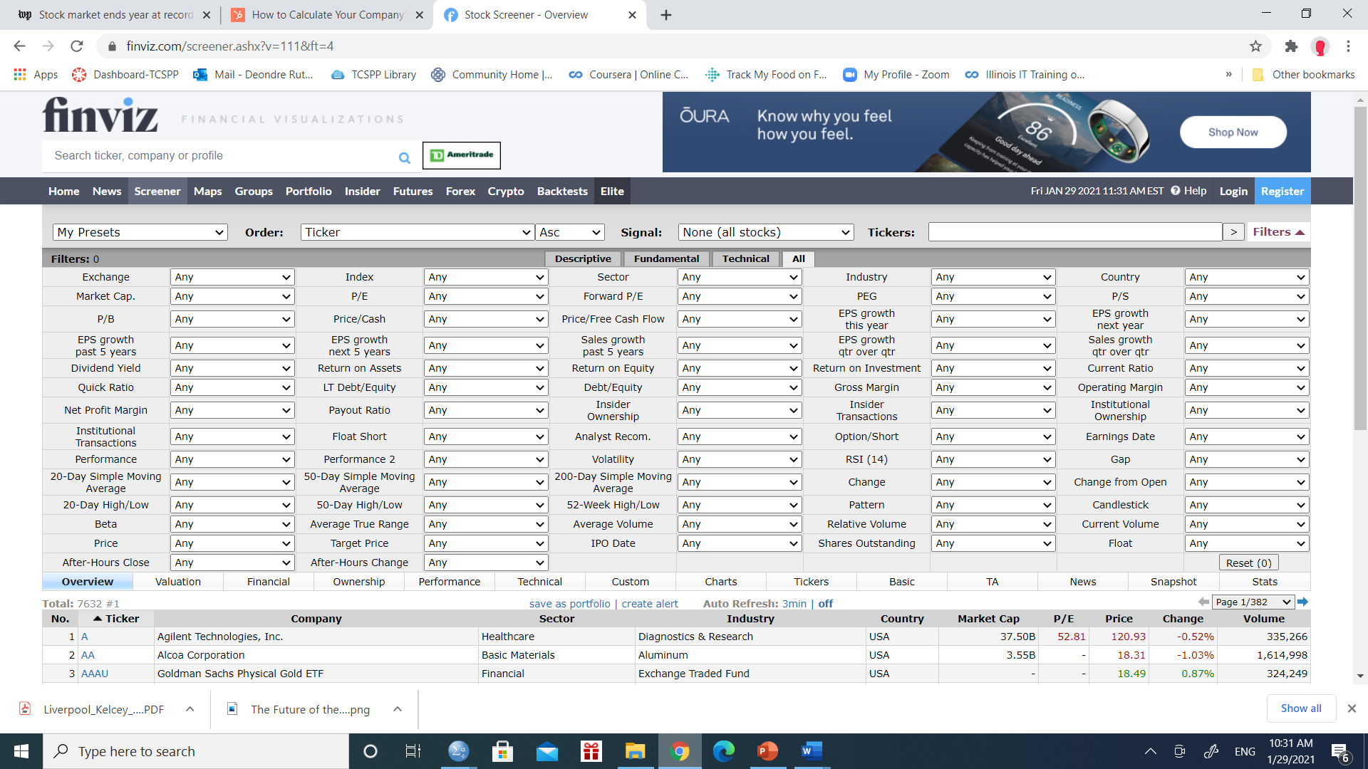

Slide 40
WHY DIVIDENDS?
PAYOUTS GIVEN OUT BY COMPANIES AS A REWARD FOR BELIEVING IN THEIR COMPANY

Slide 41
RETURN ON INVESTMENT (PROFIT)

Slide 42
Rating | 8.5/10 | 8.5/10 | 8.5/10
Min. Investments | $0 | $0 | $0
Fees | $1 a month for the Lite plan; $3 a month for the Personal Plan; $5 a month for the Family plan. | Beginner Plan: $1/month; Growth Plan: $3/month; Stash+ Plan: $9/month | No commission fees
Taxable Accounts
ETFs
Socially Responsible Investing
Individual Stocks
TOP INVESTING APPS
Acorns offers unique and fun options to fund your account and takes care of the investments for you. | Stash is unique in its ability to focus your investments into different themes based on your values. | Robinhood is free to use for its basic account and has no commissions on trades.
 | Stash offers more than 100 investment options, made up of a limited list of popular stocks and ETFs. | Its support of free cryptocurrency and options trades is unique
 | Stash offers a banking solution, which Robinhood currently does not.
Acorns if best for people who don't want to be bothered with investing. | Stash is best for new investors who want to learn. Its hybrid of self-directed and automated investing options can teach you a lot about how investing works. | Robinhood is best for active traders

Slide 43
HISTORICAL OVERVIEW
"With a good perspective on history, we can have a better understanding of the past and present, and thus a clear vision of the future." — Carlos Slim Helu
There have been 18 economic recessions in the past 100 years — averaging one every five and a half years, roughly aligning to the business cycle of four years.
*
Only two recessions have occurred in the past twenty years — 2000 to 2002 and 2008 to 2009 — making the more recent average 1 every 10 years.
*
Stocks have risen 1,100-fold over the past 70 years.
*
Dems steer clear of recessions
The last 68 years of presidents shows the economy tends to perform better when a Democrat is in the White House. Only 14 out of the 334 months with a Democratic administration were spent in recession, and most of them were inherited from Republican presidents.
*

Slide 44
WHAT HAPPENED TO GME, AMC, BB, ETC.
HEDGE FUND – PARTNERSHIP BETWEEN (HIGH EARNING, USUALLY 1M+ IN NET WORTH) INVESTORS WHO USE VARIOUS STRATEGIES TO DECREASE RISK AND MAXIMIZE RETURNS. THESE FUNDS ARE AGGRESSIVE, RISKY, AND EXCLUSIVE. THEY USE TACTICS SUCH AS SHORT SELLING FOR PROFIT
SHORT SELLING – BORROWING SHARES FROM A BROKERAGE IN ANTICIPATION OF THE STOCK PRICE DROPPING (INTEREST CHARGED BY LENGTH OF TIME STOCKS ARE HELD)
RETAIL INVESTOR – ANYONE WHO INVESTS THAT IS NOT A PART OF THE INSTITUTION
MELVIN CAPITAL* (HEDGE FUND) ATTEMPTED TO SHORT SELL MANY COMPANIES (ABOVE) VIA SHORTSELLING. AVERAGE RETAIL INVESTORS DECIDED AGAINST TO RAISE STOCK PRICE TO PREVENT THIS FROM HAPPENING.
*MELVIN CAPITAL IS PARTLY OWNED BY CITADEL LLC WHICH GAVE ROBINHOOD 40% OF ITS CAPITAL

Slide 45
ACTIVITY #3

Slide 46
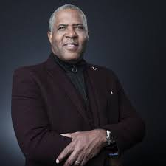
NOT EVERYONE WANTS TO MAKE THE SACRIFICE IN THE TRADE-OFF TO BECOME WEALTHIER,
AND THE FIRST PART OF THAT TRADE-OFF IS SAVINGS AND INVESTMENT AND TIME.
ROBERT SMITH, CEO VISTA EQUITY PARTNERS
FINANCIAL INSPIRATION:

Slide 47
FUCK YOU MONEY!
BONUS VIDEO & BOOK

